Slide 1
Claims

Slide 2
Objectives
Basic knowledge about the claims platforms.

Slide 3
WHAT IS A CLAIM ? WHAT COMPRISES A CLAIM
CLAIM RECOVERY
Money received from other insurers.
CLAIM HISTORY
Claim notification/settlement (status)
Policy information eg car registration no.
Claim information eg incident details
CLAIM
An event that may give rise
To a payment under a
policy
CLAIM PAYMENT
Actual payments made to policy holders.
Fast track claims will be payments only
CLAIM ESTIMATE
Guess of how much claim will cost
Could be manual estimate by claim
Handler.
Could be ACPC (calculated) estimate

Slide 4
CORPORATE MIS CLAIM STRUCTURE
CORONET
CLAIM NOTIFICATION
(HISTORY)
CLAIM ESTIMATE
CLAIM PAYMENTS
CLAIM RECOVERY
UNIX
HISTORY PLATFORM
%shr(histplat)
ESTIMATE PLATFORM
%shr(estimate)
PAYMENTS PLATFORM
%shr(payments)
RECOVERY PLATFORM
%shr(recovery)
PLATFORM FEATURES
Transaction level (1 to 1 relationship with Coronet)
Shows date and time
Monthly update using cycled file

Slide 5
CLAIMS LOW LEVEL MODEL
HISTORY PLATFORM
%shr(histplat) -all
ESTIMATE PLATFORM
%shr(estimate) -all
PAYMENTS PLATFORM
%shr(payments) -all
RECOVERY PLATFORM
%shr(recovery) - all
CLAIMS LOW LEVEL MODEL
%shr(claims) -all
Low Level Model
Loss code level summary
Contains all important details of a claim
Monthly update using cycled file

Slide 6
CLAIMS SUMMARIES, PRE SUMMARIES
CLAIMS LOW LEVEL MODEL
%shr(claims) -all
HISTORY PLATFORM
%shr(histplat) -all
CLAIMS SUMMARIES
%shr(cl_miss) - All
CLAIMS PRESUMMARIES
%shr(cl_missp) - All
Dholap Reports
Summaries
Monthly update using cycled file

Slide 7
CLAIMS DATA – USEFUL INFO
Claim Keys - AZ1 123456
Claim Branch
Claim Number
Claim Department
1 = Motor
2 = Property
3 = Liability
6 = Engineering
Loss codes - Breakdown of financial elements of a claim
Payments and estimates can include up to 4 codes on a single transaction
Recovery transactions are for a single loss code
Consist of a numerical portion , and , in some cases a character suffix. Eg 20D
Use the format $losscd to find the description of the numerical portion (using the claim department).
Use the format $lcdsuf to find the description of the character suffix (using the claim department).

Slide 8
The basic idea about the Claims platform schedules

Slide 9
CLAIMS PLATFORMS AND SUMMARIES
CLAIMS ESTIMATING
CLAIMPLT - CLEAR DOWN PLATFORMS AND LOW LEVEL SUMMARIES
CLAIM110 - CLAIMS HISTORY PLATFORM BUILD
CLAIM111 - CLAIMS ESTIMATE PLATFORM BUILD
CLAIM112 - CLAIMS PAYMENT PLATFORM BUILD
CLAIM113 - CLAIMS RECOVERY PLATFORM BUILD
CLAIM205 - CLAIMS LOW LEVEL MODEL PART 1
CLAIM210 - CLAIMS LOW LEVEL MODEL PART 2
CLAIM300 - CREATE BASE LOOKUP FILE FOR DAILY CLAIM ALERTING
CLAIM500 - CT PLATFORM MERGE
CLAIM510 - CT PAYMENTS PROCESSING
CLAIM520 - CT PRODUCE DATASETS

Slide 10
CLSUM730 - CLAIMS KPI DATA PRODUCTION
CLSUM735 - MUNICH SUSTAINABILITY REPORTS
CLEST001 - CLAIM ESTIMATING
CLMOD398 - CLAIM LOOKUP DATASETS
CLMUN010 - MUNICH CLAIM TRIANGLES
CLSUM010 - MIS SUMMARY BUILD
CLSUM020 - WORKLOAD & PERFORMANCE SUMMARIES
CLSUM030 - SETTLED CLAIMS IN LAST THREE YEARS
CLSUM040 - TIMESPAN ANALYSIS SUMMARIES
CLSUM050 - POTENTIAL RECOVERIES
CLSUM060 - RECOVERIES NOT REALISED
CLSUM070 - REOPENED CLAIMS

Slide 11
CLAIMS PLATFORMS
- CLAIMS HISTORY PLATFORM BUILD
- CLAIMS ESTIMATE PLATFORM BUILD
- CLAIMS PAYMENT PLATFORM BUILD
- CLAIMS RECOVERY PLATFORM BUILD
Claim History platform Build

Slide 12
STCHC010- This programme load the extract file (NOTCNT) and add a record to control file.
STCHP005- This programme converts monthly Claim-Notification (CLMNOTIF) extract to dataset and control file.
STCHS015 - This programme sort the monthly Notification extract dataset.
STCHC011 - This programme load the extract file (HISCNT) and add a record to control file.
STCHP020 - This programme converts claim-History (HISCNT) extract to dataset and control file.
STCHP000- This programme convert monthly claim/client key extract to dataset.
STCHS010- This programme will sort claim/client key dataset.
STCHS011- This programme sort the dataset before build Claim Broker Reference lookup table.

Slide 13
STCHP003- This programme build Claim Broker Reference lookup table.
STCHP030- This programme will merge and split the Current Months Claim History and Notifications into 'New' and 'Old' records. Also generates the warning dataset and control files.
STCHS025- This programme sort monthly Claim Histories extract dataset.
STCHP050- This programme creates Platform Records from Monthly Histories and last months latest images. (Read cycle file from that last month file).
STCHP035- This programme creates Platform Records from a combination of Notification and History records.
STCHS055 - This programme sort Platform records created from this month’s history with previous records.
STCHP060- This programme will merge last months Platform with the newly notified records and the new previously notified records to create the new History Platform. Merge with all the cycle dataset set (example: pcar, commveh, plines).

Slide 14
STCHP065- This programme update Notification/History Platform with most up to date Location ID and Client Key.
If a match between the key and the platform file is found, the platform record must be updated with the keys information.
(ii) If the first match, an image of the record as it is at present must be written to the image dataset.
(iii) Finally output the record to both image and platform datasets.
STCHS060- This programme sort the history platform dataset.
STCHP070- This programme creates the whole history platform and it is spitted into its 'mini' Prefix Platforms.
HRDPREF Macro is called and all those history platform datasets are created.
(ii) The dataset output to specific Prefix Platform dependent on the prefix falling into specific groups.

Slide 15
History platform datasets
1. bord
2. buck
3. clines
4. clines
5. commveh
6. grs
7. mbord
8. mocycle
9. niche
10. other
11. p
12. pcar
13. pcaraa
14. pcaragf
15. pcardub
16. plines

Slide 16
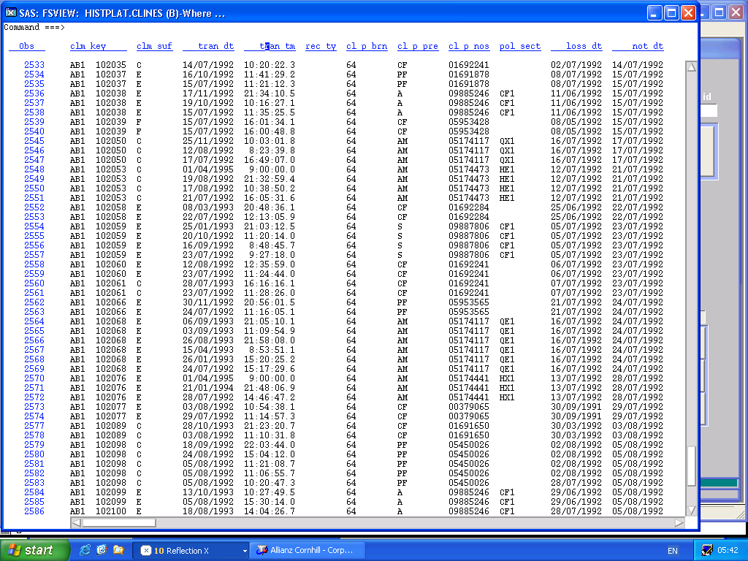

Slide 17
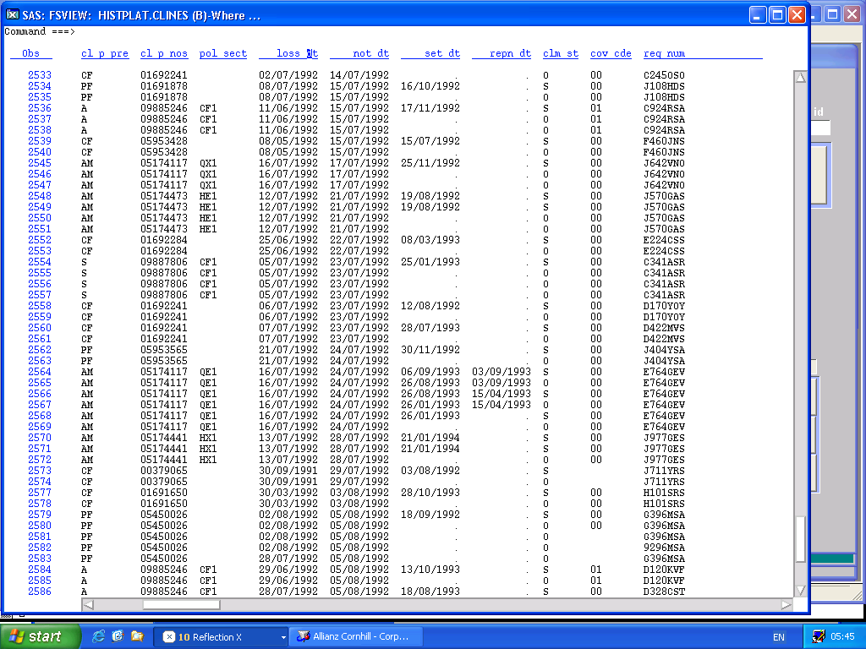

Slide 18
Questions
?
Notes:
Please feel free to ask any questions that you might have.
Thank you for listening.

